Slide 1
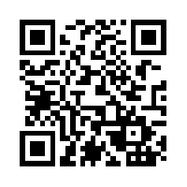
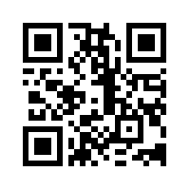
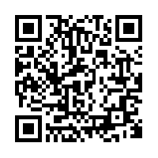
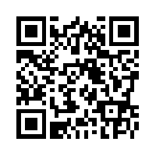
Grammar Focus:
Simple, Compound, & Complex Sentences
Compound & Complex Sentences Task Cards | Conjunction & Subordinating Conjunction Task Cards | Game- Sentence Structure http://www.quia.com/rr/126726.html
Read a book and look at the sentence structure. Can you find an example of a simple, compound, and complex sentences? Write them each down on a sticky note and add to the anchor chart. | Using Seesaw show what you know. Be as creative as you want. Review the Seesaw rubric. | No Red Ink Quiz This will be a quiz grade https://www.noredink.com
Game: Conjunctions http://www.funenglishgames.com/grammargames/conjunction.html | Watch this video to explain.. http://safeshare.tv/w/ss563687a433532 | Create a PowerPoint or poster to teach the class about the different sentence structures and conjunctions.

